Slide 1


How to Talk About Gaps
&
Challenges in Your CV
Melissa Roa
©coachingclosetoyou. All rights reserved 2025

Slide 2


Who am I
I’m a Career Coach and Certified Life & Business Coach with over 9 years of experience. I use NLP techniques to boost self-awareness and help professionals align their careers with purpose. My focus is on career strategy and growth, empowering people to move forward with clarity, confidence, structure, and intention.

Slide 3
Today you'll learn
  Reframe career gaps as valuable experiences.
  Build a strengths-based personal story.
  Use practical phrases in interviews & applications.
  Talk about challenges with confidence and hope

Slide 4
Why Career Gaps Happen
  Common reasons include:
  Health-related breaks (including disability, recovery)
  Family or caregiving responsibilities
  Education or retraining
  Relocation or personal circumstances
  Job market conditions
👉 Remember: You are not alone — gaps are common and valid.

Slide 5
Reframing Gaps as Growth
Instead of saying: “I was unemployed”
Reframe as:
  I focused on personal growth and resilience
  I gained new perspectives on problem-solving
  I developed adaptability and perseverance
  I upskilled (courses, volunteering, training)

Slide 6
Strengths-Based Storytelling
Your story has 3 parts:
  Past – What you’ve done (experience/skills)
  Gap/Challenge – Acknowledge honestly, without over-explaining
  Present & Future – What you bring now and where you’re going
Example:
“I took time out for health reasons. During this period, I built resilience and self-management skills. I’m now ready to bring this focus and determination to a new role.”

Slide 7
Practical Phrases for CV & Interviews
  “Career break to focus on health and personal development”
  “Dedicated time to retraining and upskilling”
  “Focused on family responsibilities, now excited to re-enter the workforce”
  “Transition period that strengthened my adaptability and problem-solving”
👉 Keep it short, positive, future-focused.

Slide 8
How to Talk About Challenges Without Losing Hope
Tips:
✅ Be honest, but brief – don’t dwell on the negative
✅ Highlight what you learned or developed
✅ Show readiness and enthusiasm for the next step
✅ Practice your response so it feels natural

Slide 9
Practice Exercise
In breakout groups or reflection time:
  Write 1–2 sentences you could use to explain a career gap
  Reframe it into a positive, strengths-based message
  Share (optional) with the group or chat

Slide 10
Examples of Strong Stories
Before:
“I haven’t worked for years because of my health.”
After:
“I took time out to focus on my health, and in that time, I developed resilience and strong self-management. I’m now ready to bring these strengths to my next role.”

Slide 11
Additional Tips
  Use your cover letter to address a gap briefly, if needed
  Focus your CV on skills and achievements rather than dates
  Consider a functional CV format (skills-based)
  Leverage volunteering, courses, or freelance projects as “experience”

Slide 12
Q&A / Discussion
Do you have any questions?
It is your time!
Thank you for showing up. That’s a win in itself!
You are not alone on this path
Your journey is valid and supported

Slide 13
Resources & Support
  Open Doors Initiative | Towards Work Programme
  Disability-friendly employers & job boards
  Free/affordable online upskilling platforms (Coursera, LinkedIn Learning, etc.)
  Employee Assistance Programmes / Support networks

Slide 14
Closing & Key Takeaways
  Gaps ≠ weakness → they are chapters of growth
  Own your story with confidence
  Keep explanations short, positive, and forward-looking
  You have unique strengths that employers value
“Your gap is not the end of your story. It’s part of what makes you resilient, adaptable, and valuable.”

Slide 15

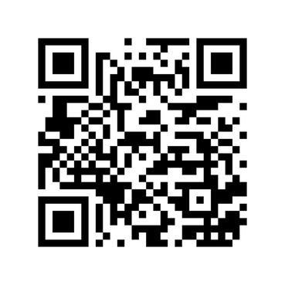
Get in touch with us!
Thank You
www.coachingclosetoyou.com
@coachingclosetoyou.en
melissa@coachingclosetoyou.com

